Slide 1
EUPATI Toolbox on Medicines R&D EUPATI National Platforms & EUPATI Fellows & Trainees Communications Webinar 18 January 2016 2pmGMT / 3pmCET

Slide 2
EUPATI Toolbox on Medicines R&D AGENDA
Introduction to the Toolbox
Jan Geissler, EUPATI Project Director
Discovering the Toolbox
Matthew May, EUPATI Work Package 4 Leader
Adapting and sharing the Toolbox
Kay Warner, EUPATI Work Package 4 Co-Leader
Communications around the Toolbox
Rob Camp, EUPATI Communications Manager
National activities and the Toolbox
Laura Kavanagh, EUPATI National Platforms Coordinator
Notes:
Toolbox will be publicly launched on 27 January 2016 online at www.eupati.eu in 7 European languages [English, French, Spanish, German, Italian, Polish and Russian]. DISCOVER! ADAPT! SHARE!

Slide 3
EUPATI Toolbox on Medicines R&D The vision for the Toolbox & The plans in Germany Jan Geissler, EUPATI Project Director

Slide 4
The EUPATI Toolbox – viewpoint of Jan in his role as the EUPATI Director
The Toolbox is our flagship “product” of this 5-year EUPATI project
Tremendous new resource
Built on EUPATI Patient Expert Training Course & feedback received
7-lingual
Intends to reach 12,000+ and 100,000+ people
To be re-used and built upon by patient advocates (“discover, adapt, share.”)
Hopes and aspiration on use of Toolbox
Use it for your own patient community
For example:
How do CT work? What about pharmacovigilance? Differences and similarities of generics and originator products?
Adapt: Why is in especially important for the cancer community, a specific rare disease community, etc?

Slide 5
The EUPATI Toolbox – viewpoint of Jan as German National Platform Chair
National Webinar 1 – how does clinical development work
National Webinar 2 - what is the role of science in medicines R&D, what is the role of industry, how does patient involvement work
Framework of patient involvement across R&D lifecycle
Practical advocacy example 1 – HIV
Practical advocacy example 2 – Patient-driven Biobank
EUPATI Toolbox demo, and how does it apply to patient advocacy
All released to announce German National Platform launch on 20 Jan 2016
Motivation – to reach all patients and advocacy groups, independent of affiliation and level of organisation
Patient involvement in R&D in Germany is not as developed as in other countries. Focus so far on care & reimbursement, not research design and conduct
Launch on Facebook page, Press release to be sent via ENP Executive Committee (POs, Academia, Industry, Health Ministry, CA)

Slide 6
EUPATI Toolbox on Medicines R&D Discovering the Toolbox Matthew May, EUPATI Work Package 4 Leader

Slide 7
The EUPATI Toolbox – Demonstration
Vimeo

Slide 8
EUPATI Toolbox on Medicines R&D Adapting and sharing the Toolbox Kay Warner, EUPATI Work Package 4 Co-Leader [Content Development Workstream]

Slide 9
Public license model guarantees ownership and re-use by the public
What we bring in and what we produce is free for unlimited use by the public
You may:
Share tools: copy & redistribute in
any medium/format
Adapt tools: remix, transform, & build upon the material
You must:
Give appropriate credit
Provide a link to the license
Indicate modifications
Distribute adapted content under creative commons license
You may not:
Use the licensed material for commercial purposes
Notes:
We have produced www.eupati.eu and the EUPATI Toolbox under a Creative Commons Attribution-NonCommercial-ShareAlike 4.0 (CC BY-NC-SA 4.0) license.
This means that we give permission to any public third party to share and ADAPT our creative work as long as all copyright notices for the work – including original sources – are kept intact and as long as the use is non-commercial. This use is free.
By licensing our work with the CC BY-NC-SA 4.0 license it means that you may:
o Share — copy and redistribute the material in any medium or format
o Adapt — remix, transform, and build upon the material within the boundaries of copyright law on non-commercial basis
It does however mean that when you use it you must:
o Authorship and licensing needs to stay intact and mentioned on all derivatives - give appropriate credit, you must provide the name of the creator and attribution parties (i.e, EUPATI), a copyright notice, a license notice, a disclaimer notice, and a link to the material
o provide a link to the license – https://creativecommons.org/licenses/by-nc-sa/4.0/
o indicate if you modified the material and retain an indication of previous modifications
o If you remix, transform, or build upon the material, you must distribute your contributions under the same license as the original (CC BY-NC-SA 4.0). You may not apply legal terms or technological measures that legally restrict others from doing anything the license permits.
You can do this in any reasonable manner, but not in any way that suggests that EUPATI endorses you or your use.
Example if you have not changed anything:
“Phases of Clinical Development” by EUPATI is licensed under CC BY-NC-SA 4.0
Example if you have changed something:
“My clinical trials guide” is a derivative of “Phases of Clinical Development” by EUPATI used under CC BY-NC-SA 4.0. “My clinical trials guide” is licensed under CC BY-NC-SA 4.0 by [insert editor’s name]
Similarly applied by e.g. WikiPedia, Google and many others
The above is an easy to read summary of, but does not substitute the legal text of the license which is available to read and for download at https://creativecommons.org/licenses/by-nc-sa/4.0/legalcode
Anyone who wants to use EUPATI material for a commercial purpose must contact licenses@eupati.eu to understand options.

Slide 10
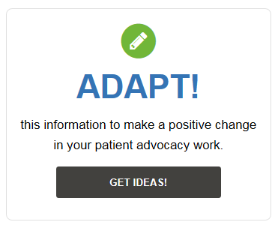
How can content from toolbox be adapted?
Supplement your existing presentations covering specific subject matter by adding presentation slides from EUPATI
Raise awareness of medicines R&D process using factsheets and add on top of your own disease based material
Develop training sessions by adapting content to produce pre-reading, handouts, workbooks and quizzes
Free to use images and diagrams

Slide 11
Some examples of how tools might be used nationally - top 5 ways
Produce an information leaflet or poster
Organise regional events or simulate sessions for patients and healthcare professionals to explore specific challenges and solutions
Prepare for discussions or meetings with our EUPATI factsheets, and adapt the to suit the situation in your country
Plan an awareness-raising event and invite a speaker from your national group to talk to your members
Use our EUPATI tools to develop specific training - pre-reading, handouts, workbooks and quizzes.
Personal study/self-learning or group learning
Notes:
Is your patient community new to medicines R&D? Produce an information leaflet or poster by adapting EUPATI articles on how medicines are made . http://www.eupati.eu/making-medicine-step-1-pre-discovery/.
Is there an opportunity to improve patient involvement in research ethics committees in your country? Use the EUPATI tools to organise regional events or simulate an ethics committee session for patients and regional hospital staff to explore challenges and solutions.
http://www.eupati.eu/research-ethics-committees-rec/
Do you want to address the issue of compensation for patient participation in clinical trials with national partners? Prepare arguments for your meeting with our EUPATI factsheet, and adapt the EUPATI table of compensation models to suit the situation in your country!
http://www.eupati.eu/compensation-clinical-trials/
Are you struggling to explain to other patients how medicines get approved? Plan an awareness-raising event and invite a speaker from your national regulatory authority to talk to your members using our EUPATI presentation http://www.eupati.eu/wp-content/uploads/2015/09/Presentation-Marketing-authorisation-v1_EN.pptx
Want to organise a training on health technology assessments for patients? Use our EUPATI tools to develop training pre-reading, handouts, workbooks and quizzes. http://www.eupati.eu/fundamentals-of-health-technology-assessment-process/ Select examples of patient involvement in HTAs which might work for your country from the list in the EUPATI article http://www.eupati.eu/patient-involvement-in-hta/

Slide 12
QUESTIONS & ANSWERS Laura

Slide 13
EUPATI Toolbox on Medicines R&D Support from EUPATI for national activities Rob Camp, EUPATI Communications Manager

Slide 14
Goal – use of EUPATI website/system
Virtual postcards: December 2015 – February 2016
Press release: 27 January 2016
Promotional video: 22 January 2016
NEW general leaflets and posters: February (?)
Bi-weekly thematic focuses: March 2016 – January 2017
Develop simple messages at various key points that you can copy and paste to your own (personal) networks and use within their organizations.
Bi-weekly thematic focuses:
Mar – Safety of Medicines
Apr – HTAs
May – Clinical dev & trials
Jun – Basics of medicines
Jul – Personalised medicines
Aug – Benefit & risk assessment
Sept – Advocacy
Oct – Drug discovery/development
Nov – Non-clinical studies
Dec – Regulatory affairs
Jan – pharmacoepidemiology

Slide 15
DISCOVER! ADAPT! SHARE!
#EUPATI_toolbox: A - Z of medicines development for direct use & to help create your own material - www.eupati.eu/es
Medicines safety; the value of health technology; and much more. Discover! Adapt! Share! www.eupati.eu/fr
EUPATI toolbox is fully searchable and mobile friendly. Discover! Adapt! Share! www.eupati.eu/de
#EUPATI toolbox: 83 topics within 16 medicine research categories. Discover! Adapt! Share! www.eupati.eu
Promo video as of 22 January
Looking for a glossary of terms used in medicines development? Coming soon the #EUPATI toolbox

Slide 16
.
Notes:
We can keep these messages going into february and beyond, basically removing the date and repeating…

Slide 17
Getting started
Communications budget
Have you started to implement it? What do you think you might need?
Report and feedback on how the toolbox is being used, ie,
forum to share how tools have been adapted
patient advocate of the year competition (adv of the month?)
web analytics and exit survey responses can help shape this approach.
Develop catchy slogans and question-style posts (such as what is your favourite research topic? Which trial design is most relevant to you? Are clinical trials last resort?) as options for social media campaign, in partnership with trainees
How can we implement the above, and What else can EUPATI do?

Slide 18
2016 – the year of communication!
Daily tweets & ENGAGEMENT
Quarterly newsletters
Media outreach
Bi-weekly posts & ENGAGEMENT

Slide 19
EUPATI Toolbox on Medicines R&D National activities & the Toolbox Laura Kavanagh, EUPATI National Platforms Coordinator

Slide 20
ENP Action Plan 2016 – Discovering, Adapting & Sharing the TOOLBOX
EACH NATIONAL PLATFORM will:
February or March
1 national webinar/event to introduce the EUPATI TOOLBOX
General webinar to provide information - Ireland
EUPATI National Platform launch including Toolbox - Switzerland
March - December
1 national event to address a topic or tools from the EUPATI TOOLBOX
HTA training with the National Centre for Pharmacoeconomics - Ireland
Patients & industry meeting with Association of British Pharmaceutical Companies - UK
Clinical research for a non-clinical audience
Ongoing with support from LOCAL COMMUNICATION CONSULTANT/COMPANY
Daily tweets, bi-weekly facebook posts, quarterly newsletters, media outreach
Notes:
We hope that National Platforms and EUPATI fellows and trainees can really work together here to get a buzz going at the national level around discovering the Toolbox, adapting it to produce new country specific material, and sharing it widely with as many patients and other interested partners as possible!
We’d like to think that across 2016, it might be possible for each ENP to organise:
A national webinar or event to inform about the Toolbox: information sharing event [along the lines of what we have done here today]
A national event to explore the Toolbox and a particular topic within the Toolbox [along the lines of the examples I shared with ENPs on Friday in the ENP Dissemination Guide, or along the lines of the thematic webinar examples shared by Jan]
Ongoing communication via email, national media outlets, and via national EUPATI social media engagement [this is the important bit, unlike one-off events, this is regular communication with patients interested in patient education and patient involvement.] We have some funds in a communication cash pot to help procure national communication expertise, but I think ENP members and EUPATI fellows/trainees also have a role to play here.

Slide 21
5***** NATIONAL PLATFORM will:
ENP Action Plan 2016 – Discovering, Adapting & Sharing the TOOLBOX
April to December
3-5 regional roadshows to take the “EUPATI TOOLBOX on the ROAD”
Ideally take a national health partner with you, and some EUPATI fellows/trainees
ENP + Irish trainees + IPPOSI CEO + Irish Clinical Trials Centre go to Galway
Italy, Spain, Poland
November+
1 national conference to discuss the future of patient education/involvement
Notes:
If we see the previous slide as something we hope all ENPs will do – we see this slide as something which we hope the more established ENPs will be able to manage in addition
1 regional roadshow: spreading the message widely, reaching patients outside the capital, reaching patients who may be in much need of this new information and this new resource.
1 national conference: at the end of the year, showcasing your activities and achievements to national health partners, hopefully many will be on board with EUPATI and with the vision for patient education and patient involvement by then, but this will convince those who still have doubts that patient education has tangible benefits and can be practically implemented.

Slide 22
Ongoing communication – Local communication consultant, EUPATI fellows/trainees & ENP members
We ALL need to join the online conversation to make sure that we engage our followers as much as possible! That way we get a debate going, which hopefully promotes new ideas and ultimately change. If we only receive information, we tend to limit what happens.
When you tweet remember to include @EUPATI_UK or @EUPATI_IT etc
We should have local language newsletters, anyone can write an article, so if you’re feeling creative…..
Daily tweets
Quarterly newsletters
Ask me to make you an editor on the page, you can then post as the page rather than as a visitor!
We should all use our media contacts to spread the word. We should also think about how to outreach.
Bi-weekly posts
Media outreach
Notes:
This is the really important bit!
Webinars and events are important – they are high profile, they get people interested, but it is the ongoing communication that keeps them engaged, that keeps them coming back to the Toolbox for more information, that keeps them passionate about patient education and patient involvement and that encourages them to get involved with the National Platform and build a national network of patients, academia and industry who work together for change!

Slide 23
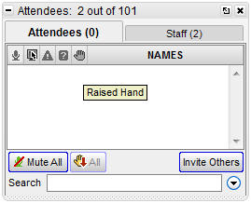
QUESTIONS & ANSWERS Please ‘raise your hand’. To raise your hand, go to the attendee section, click on the 5th icon, this is the icon with the hand symbol [see above].

Slide 24
EUPATI TOOLBOX on Medicines R&D Slides

Slide 25
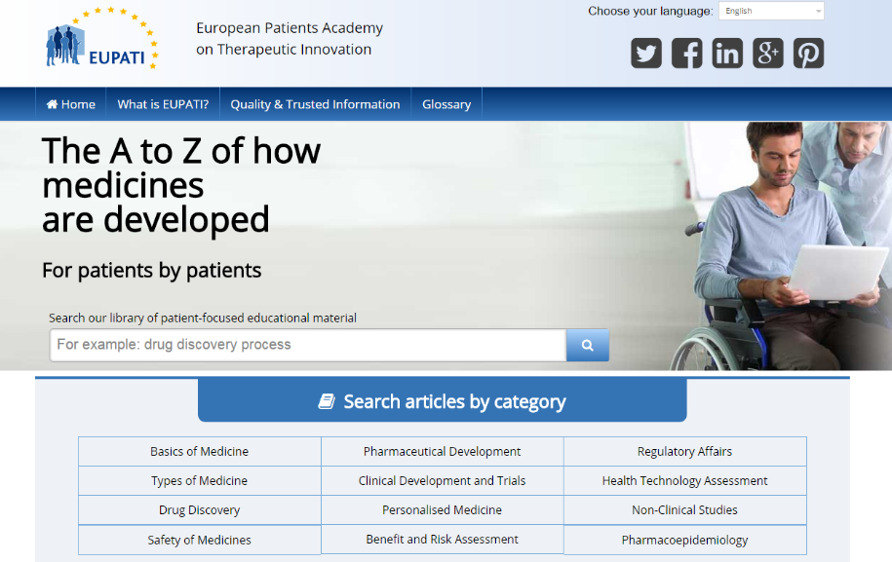
EUPATI Toolbox – A-Z of medicines R&D
Notes:
So on to the EUPATI Patient Advocate Toolbox. Here in EUPATI we are all very excited about the Toolbox. Not only because we have been working on it together for so many months and we can now final see the finished material, but because we hope that the Toolbox will be a game changer in patient education about medicines research and development. Unlike the course which only reaches 100 patients, we hope that the Toolbox can reach thousands, and even tens of thousands.
We hope that patient communities will take this material and use it in their training sessions, publish it on their websites, and adapt it to suit the needs of their members. In doing so, we hope that more patient experts will emerge who are willing and capable of taking up a place at the decision-making table – sitting side-by-side with researchers, pharmaceutical company representatives, regulators and other important stakeholders – making the patient voice heard.

Slide 26
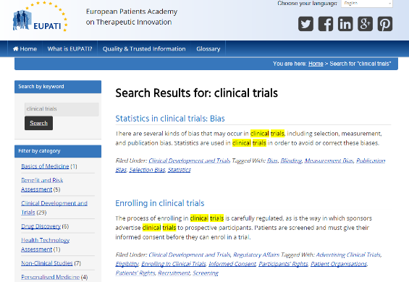
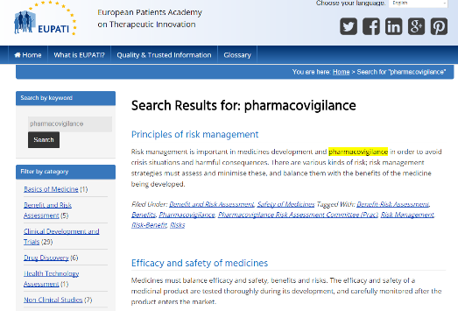
EUPATI Toolbox – Content
Medicines development
Personalised medicine
Drug safety, risk/benefit
Pharmaco-economics, HTAs
Clinical trials
Patient roles & responsibilities
Notes:
So what is the Toolbox all about? What’s in it?
The Toolbox covers a range of topics around medicines research and development.
The material is sourced from the EUPATI Patient Expert Training Course, simplified and adapted into an online, downloadable, printable format.
Topics addressed include: Medicines development process from research to approval; Personalized and predictive medicine; Drug safety and risk/benefit assessment of medicines; Pharmaco-economics, health economics and health technology assessment; Design and objectives of clinical trials (& roles of stakeholders); Patients roles & responsibilities in medicines development

Slide 27
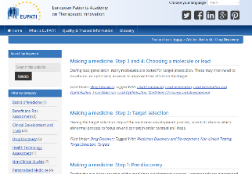
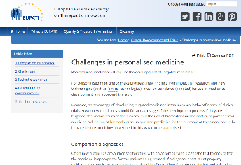
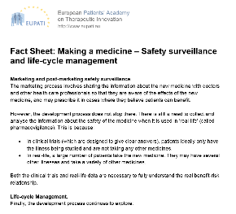
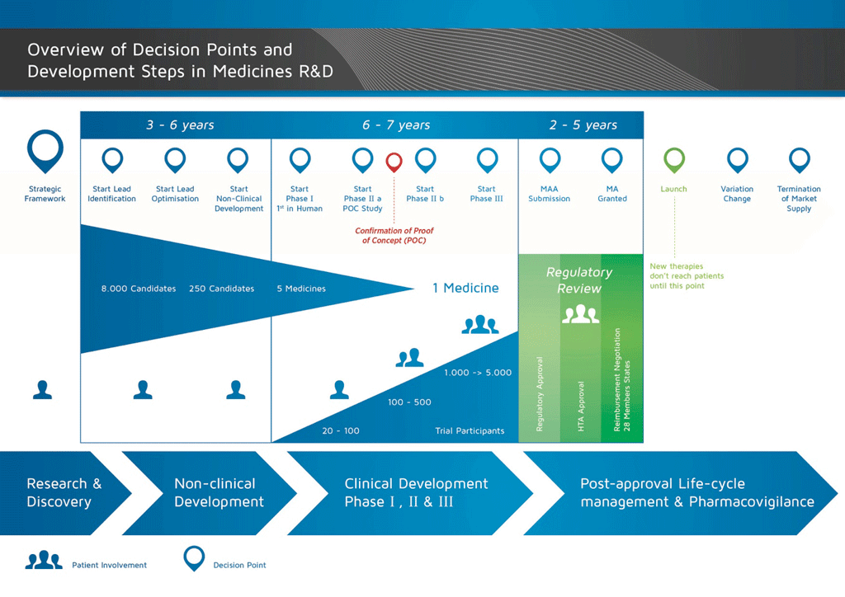
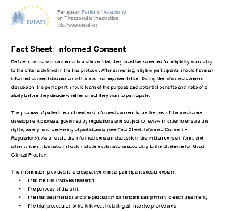
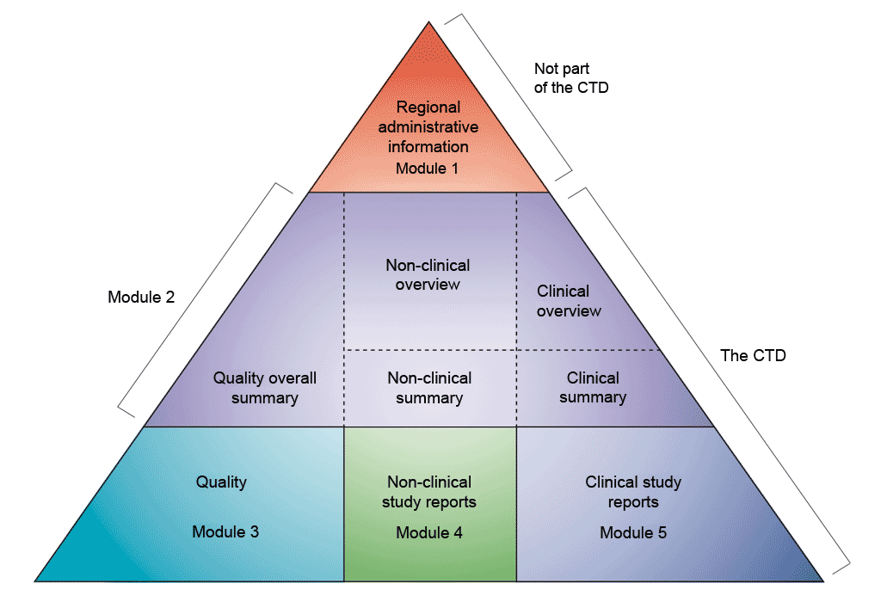
EUPATI Toolbox – Formats
PowerPoints
Articles
Infographics
Fact sheets
Notes:
The Toolbox is not just a medicines R&D Encyclopedia, it can be a tool for self-learning, or it can be a tool for teaching others, for trainers.
With this in mind, we’ve included tools in a range of formats, to try and suit as many audiences as possible. As a result you will find:
Articles [short description]
PowerPoints [short description]
Infographics [short description]
Factsheets [short description]
In the coming months, we hope to also add XX, XX, and XX.

Slide 28
EUPATI Toolbox – Languages
French
Italian
Spanish
German
Polish
Russian
English
Notes:
Unlike the EUPATI Patient Expert Training Course which we talked about earlier, the Toolbox is available the seven languages of the project: English, French, Spanish, Italian, German, Polish, and Russian.
We hope that by providing access to patient education material in so many languages that we can reach more patients and effectively start to grow that large movement of patient experts which we talked about earlier – 1,000s, 10,000s.
And we don’t want it to stop here. We hope that patients, academics and industry representatives in countries where other languages are spoken will find the toolbox material of interest and source funds to make translations available locally.

Slide 29
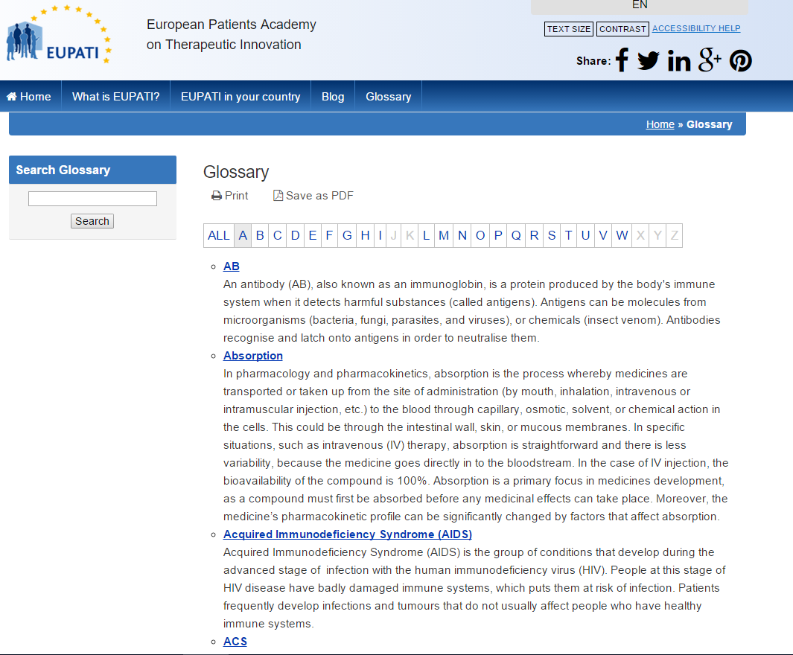
EUPATI Toolbox – Glossary

Slide 30
EUPATI Toolbox – Country pages
EUPATI has established national networks or ‘National Platforms’
Platforms bring national partners – patients, academics & industry – together
Platforms identify national patient involvement priorities & challenges
Platforms organise activities/events to help national partners discuss important issues
Platforms reach out to policy and decision-makers in government departments, regulatory bodies, ethics committees etc
Notes:
EUPATI is not just European, EUPATI is national, EUPATI is local.
We can only really make a change and get more patients involved in medicines R&D if we work at the national level, with local people in their own languages.
As such, we rely heavily on our National Platforms to spread the word about EUPATI and to guide individual patients and patient communities interested in medicines R&D. In 2016, we hope that National Platforms will be busy talking about the Toolbox and organizing events to showcase the Toolbox to others. National Platforms will play an important role in helping patient communities locally to adapt the Toolbox to their education and training needs.
We want to grow National Platforms as much as we can, and so if you are interested in joining, please contact your National Team using the link to your country displayed on the EUPATI homepage.

Slide 31
EUPATI TOOLBOX & National activities Slides

Slide 32
1 national webinar/event INFORMATIVE

Slide 33
Information webinar: agenda 30 minutes
ENP Chair introduces Toolbox & vision [10minutes]
This could also be a EUPATI consortium member if there is someone who speaks your language:
Spanish = Rob Camp
French = Eurordis
German = Matthew May, Jan Geissler, Ingrid Klingmann, David Haerry
Italian = Silvano Berioli, Ilaria Piuzzi
Polish = ?
Navigation of the Toolbox
Panel discussion about how to discover! adapt! and share!
[10 minutes]
ENP member
National partner with interest in HTA
National partner with interest in Clinical Trials
National partner with interest in ??
Q&A

Slide 34
1 national event/webinar THEMATIC

Slide 35
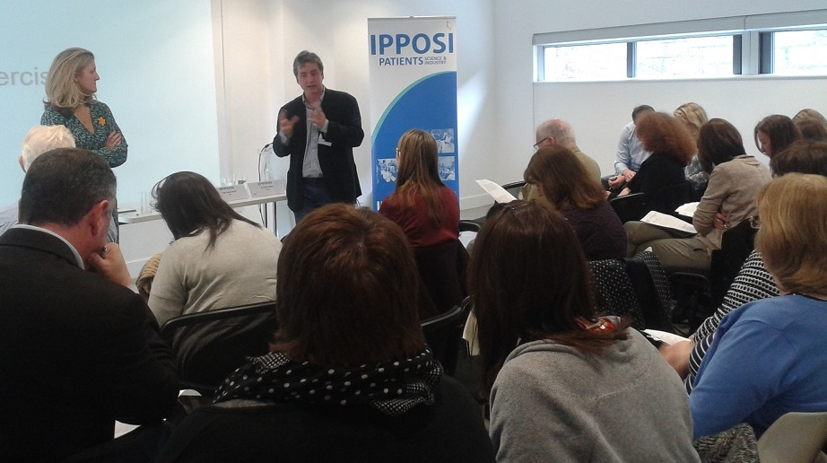
HTA training: agenda ½ day event
Keynote from EUPATI trainee about the benefits of studying course HTA module [5minutes]
Presentation by national authority about HTA process and the role for patients [90 minutes]
Practical use exercise in HTA [90minutes]
Ask national authority to ask participants to review case studies of recent medicines up for review and the framework for evaluating them.
REMEMBER:
Send relevant section of Toolbox as pre-reading
Use slides, infographics, videos from Toolbox in presentations
Consider preparing quiz questions based on Toolbox content

Slide 36
Clinical research training: agenda
Views of the research expert [20minutes]
Understanding research design
Evaluation of statistics in clinical trials
Hierarchy of evidence
Views of development expert [20minutes]
Terminology / Conventions
Medicines development pathway
Consent
Rules & regulations
Clinical Trial Process
Forthcoming developments
Views of the patient expert [30 minutes]
Challenges & opportunities for clinical research
Views from the floor [30 minutes]
REMEMBER:
Send relevant section of Toolbox as pre-reading
Use slides, infographics, videos from Toolbox in presentations
Consider preparing quiz questions based on Toolbox contentC

Slide 37
Orphan drugs roundtable: agenda
Question 1 [60 minutes]
Patient expert in orphan drugs
Academic expert in orphan drugs
Industry expert in orphan drugs
Relevant national partners [HTA, regulatory, government, policy etc]
Best practice nationally or internationally
Question 2 [60 minutes]
Patient expert in orphan drugs
Academic expert in orphan drugs
Industry expert in orphan drugs
Relevant national partners [HTA, regulatory, government, policy etc]
Best practice nationally or internationally
Audience comments [30 minutes]
REMEMBER:
Send relevant section of Toolbox as pre-reading
Use slides, infographics, videos from Toolbox in presentations
Consider preparing quiz questions based on Toolbox contentC

Slide 38
3-5 regional roadshows “EUPATI TOOLBOX on the ROAD” INFORMATIVE or THEMATIC

Slide 39
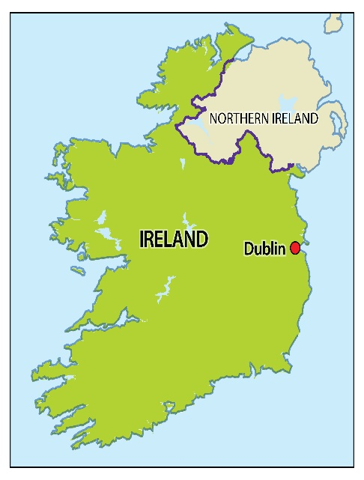
Regional Roadshow: agenda
ENP Chair introduces EUPATI and the educated patient [20 minutes]
ENP member gives a practical demonstration of the Toolbox [10minutes]
Panel of patients, academic and industry debate the benefits of patient education and the opportunities for patient involvement in medicines R&D [30 minutes]
Discussion with the audience [30 minutes]
REMEMBER:
Play promotional video to introduce Toolbox
Share leaflets on the Toolbox at the event
Use examples from Toolbox in presentations
e.g Irish roadshow

Slide 40
1 national conference SUSTAINABILITY

Slide 41
National conference: agenda
Keynote by EUPATI fellow/trainee
Presentation of ENP activities in 2016 by ENP Chair
Examples of the successful adaption and sharing of the Toolbox nationally
Panel: Benefits of patient education [patient, academic, industry, other] to discuss 3-4 questions around patient education and patient involvement
Discussion: sustainability of the EUPATI National Platform and the value of partnership working: Patients-Academia-Industry
…….other ideas

Slide 42
ENP best practice

Slide 43
ENP activities in 2016
Ireland: 17 February National webinar, April+ “EUPATI on the Road” – The National Platform team up with EUPATI fellows to bring the Toolbox to patients and the public in the major cities [Galway, Limerick, Cork, Belfast].
Spain: Biobanking
Italy: April, National conference
Austria: Workshop on paediatric medicine
Germany: February+ National webinars on clinical research
UK: Event on patient and industry interaction with ABPI
France:

